Slide 1

Python workshop
Week 3: Loops and strings
barbera@van-schaik.org

Slide 2
Overview of this workshop series
Week 1: Writing your first program
Week 2: Make choices and reuse code
Week 3: Loops and strings
Week 4: Files and lists
Week 5: Dictionaries and tuples
Acknowledgments: Structure of the workshop follows the book
“Python for informatics” by Charles Severance.
Several examples are from this book or the accompanying slides.

Slide 3

Loops
Notes:
https://s-media-cache-ak0.pinimg.com/originals/d9/8c/e7/d98ce7fa25410cc283eb9feb4343f86c.jpg

Slide 4
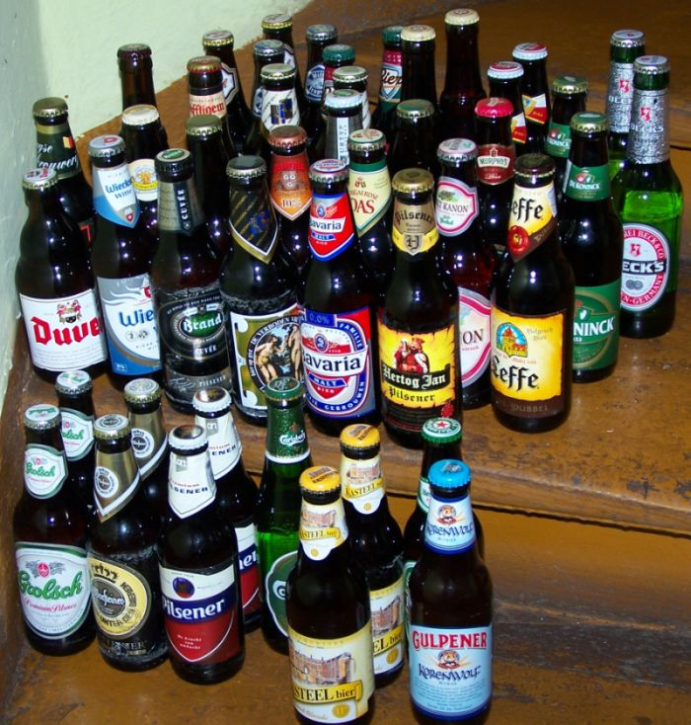

99 bottles of beer
99 bottles of beer on the wall, 99 bottles of beer.
Take one down, pass it around, 98 bottles of beer on the wall...
98 bottles of beer on the wall, 98 bottles of beer.
Take one down, pass it around, 97 bottles of beer on the wall...
.
.
No more bottles of beer on the wall, no more bottles of beer.
Go to the store and buy some more, 99 bottles of beer on the wall...
Try this script and fix the error:
bottles-of-beer-contains-error.py
You can refine this script to deal
with the case of 1 bottle of beer
Notes:
https://en.wikipedia.org/wiki/Beer

Slide 5
99 bottles of beer
n = 99
while n>0:
if n > 0:
print(n, "bottles of beer on the wall,", n ,"bottles of beer.")
n = n - 1
print("Take one down, pass it around,", n, "bottles of beer on the wall...\n")
if n == 0:
print("No more bottles of beer on the wall, no more bottles of beer.")
print("Go to the store and buy some more, 99 bottles of beer on the wall...\n")

Slide 6

Declaration of a variable
>>> x = x + 1
You can't use/update a variable that doesn't exist yet
>>> x = 0
>>> x = x + 1
Declaration of
X
Notes:
http://www.gograph.com/vector-clip-art/scroll-shapes.html

Slide 7
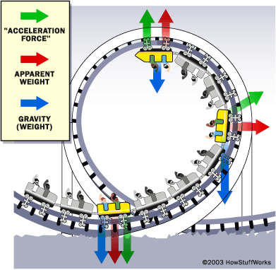
What happens in a loop?
Evaluate the condition, True or False
If the condition is false, exit the while statement and continue execution at the next statement
If the condition is true, execute the body and then go back to step 1
Notes:
http://science.howstuffworks.com/engineering/structural/roller-coaster7.htm

Slide 8
Infinite loops
∞
Try: bottles-of-beer-infinite-loop.py
With CTRL+C you can stop the program
Then try: bottles-of-beer-contains-error.py

Slide 9
Infinite loops
∞
n = 99
while n>=0:
if n > 0:
print(n, "bottles of beer on the wall,", n ,"bottles of beer.")
n = n - 1
print("Take one down, pass it around,", n, "bottles of beer on the wall...\n")
if n == 0:
print("No more bottles of beer on the wall, no more bottles of beer.")
print("Go to the store and buy some more, 99 bottles of beer on the wall...\n")
You need to make sure that the loop can end

Slide 10
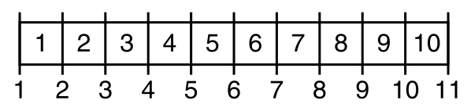
Type of errors
Syntax error (typos, forgetting closing quotes)
  Python will give an error
Logic error
  seconds = hours / 3600
  average = a + b / 2
Off-by-one error
Off-by-one or fence-post error
Notes:
https://en.wikipedia.org/wiki/Off-by-one_error

Slide 11
Useful infinite loops
Let a sensor measure the temperature endlessly
Ask user for input until an answer is correct
while True:
line = input("Say 'when'> ")
if line == 'when':
break
print(line)
print('Done!')
say-when.py

Slide 12
continue and break
while True:
line = input('> ')
if line[0] == '#' :
continue
if line == 'done':
break
print(line)
print('Done!')
Example from the book
continue-and-break.py

Slide 13
for loops
applepie.py
groceries = ["apples", "flour", "butter", "eggs", "sugar"]
for item in groceries:
print("Don't forget the", item)
snoepjes.py
for i in range(10):
print(i, "Ik mag niet met snoepjes gooien")

Slide 14
Count stuff
total = 0
for i in [32, 45, 8, 10, 25]:
total = total + i
print("Total:", total)
Example from book
count-stuff.py

Slide 15
Maximum
largest = None
print('Before:', largest)
for itervar in [3, 41, 12, 9, 74, 15]:
if largest is None or itervar > largest :
largest = itervar
print('Loop:', itervar, largest)
print('Largest:', largest)
Example from book
get-maximum.py

Slide 16

Wrap-up
A loop usually has the following
  A variable is declared (counter or something finite)
  Evaluation (conditional) of variable to end the loop
  Something is done in the loop
Notes:
http://www.zazzle.com/snake+pattern+wrappingpaper

Slide 17
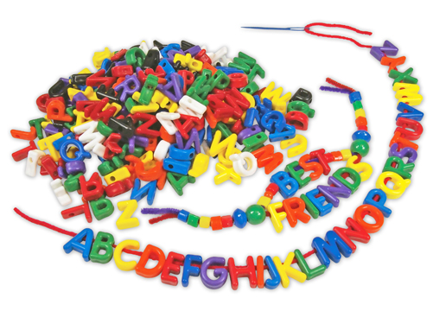
Strings
Notes:
http://www.roylco.com/product/R2184/language/2/Manuscript_Letter_Beads

Slide 18
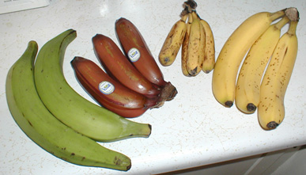
Strings
A string is a sequence
>>> fruit = “banana”
>>> letter = fruit[1]
b | a | n | a | n | a
0 | 1 | 2 | 3 | 4 | 5
Notes:
https://en.wikipedia.org/wiki/Banana

Slide 19
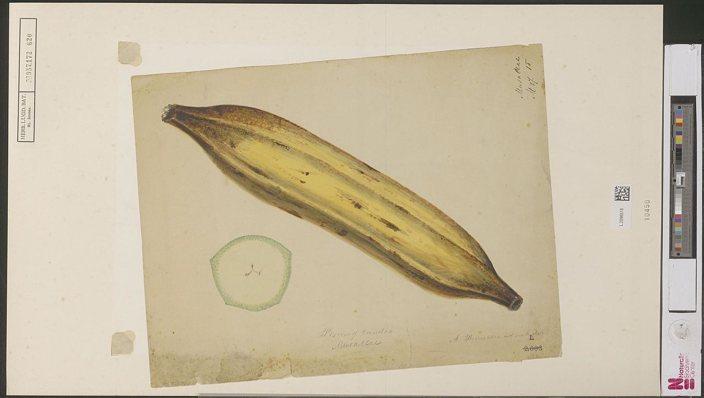
Length and indices
Length
>>> len(fruit)
Get the last index
>>> length = len(fruit)
>>> last = fruit[length]
>>> last = fruit[length-1]
Get the last letter
>>> fruit[-1]
Notes:
https://en.wikipedia.org/wiki/Banana

Slide 20
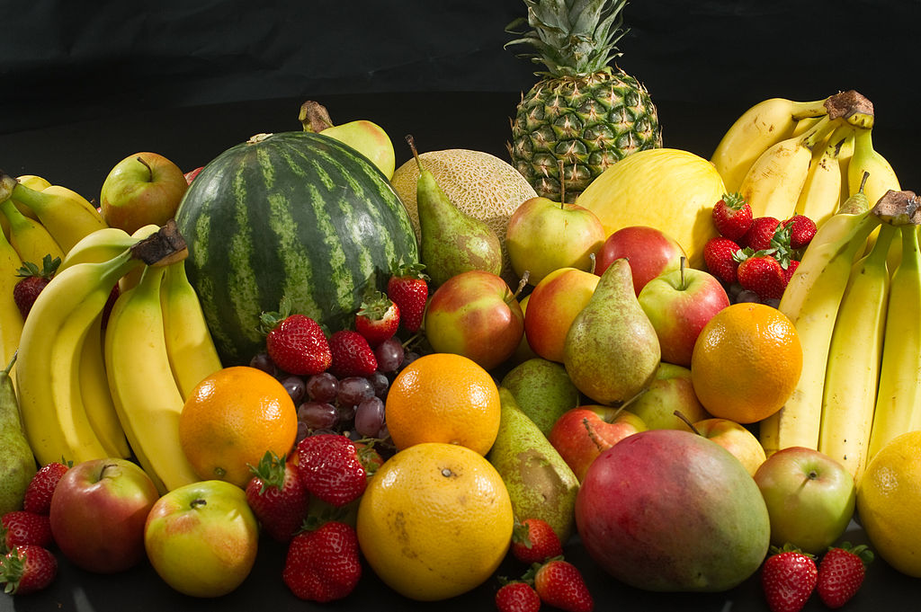
Letter by letter: while loop
index = 0
while index < len(fruit):
letter = fruit[index]
print(letter)
index = index + 1
Notes:
https://en.wikipedia.org/wiki/Fruit

Slide 21
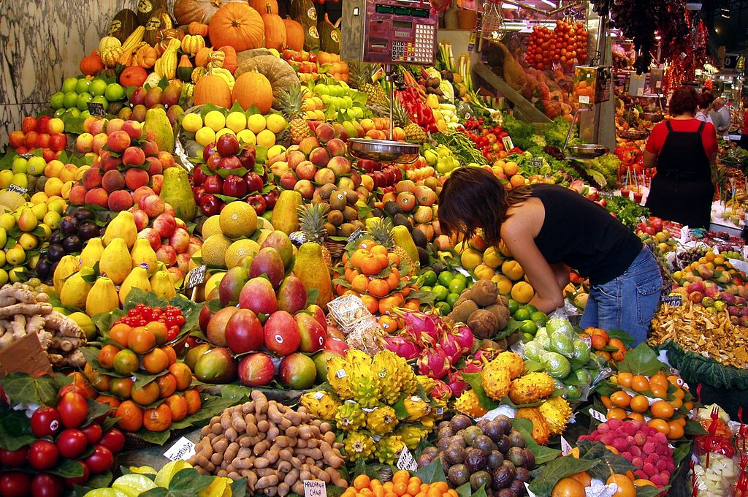
Letter by letter: for loop
for letter in fruit:
print(letter)
Notes:
https://en.wikipedia.org/wiki/Fruit

Slide 22
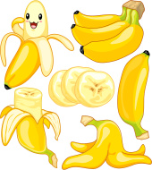
Slices
>>> s = “banana”
>>> s[0:3] # ban
>>> s[:3] # ban
>>> s[3:] # ana
>>> s[3:3] # ''
>>> s[2:5] # nan
>>> s[:] # banana
Notes:
http://www.freeimages.com/search/cartoon-banana

Slide 23
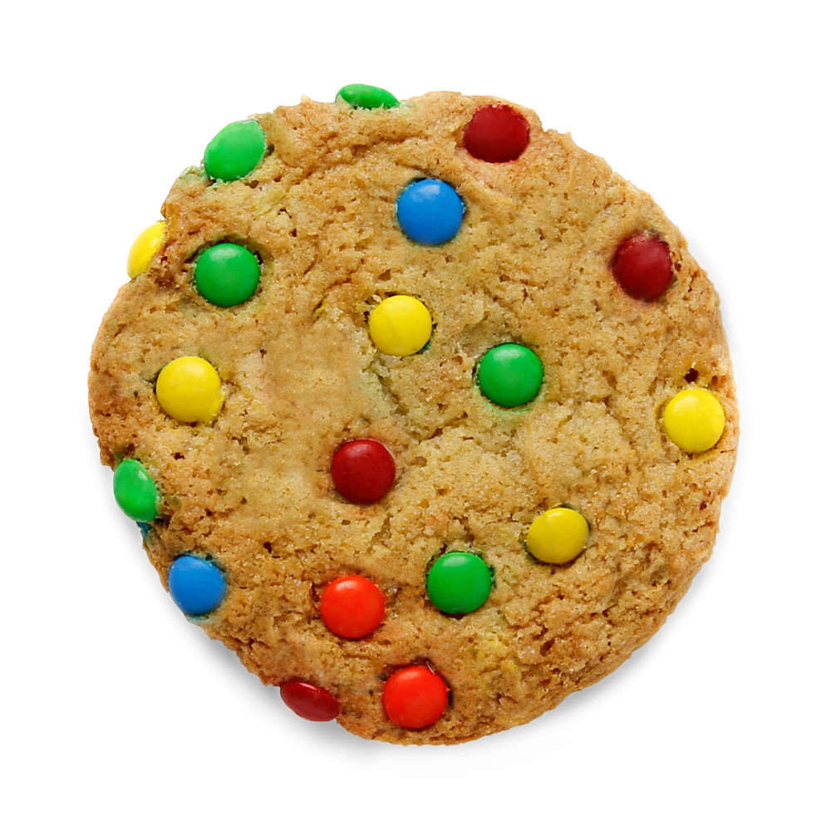
Mutability
>>> x = "cookies"
This will give an error:
>>> x[0] = “b”
Solution, use slices:
>>> new = x[:3] + "l"
>>> print(new)
Notes:
http://www.thegreatcookie.com/collections/cookies

Slide 24
Count letters
Write a program that counts all the a's in 'banana'
Hint
  for loop
  a variable to count
  if statement to check if the letter is an a

Slide 25
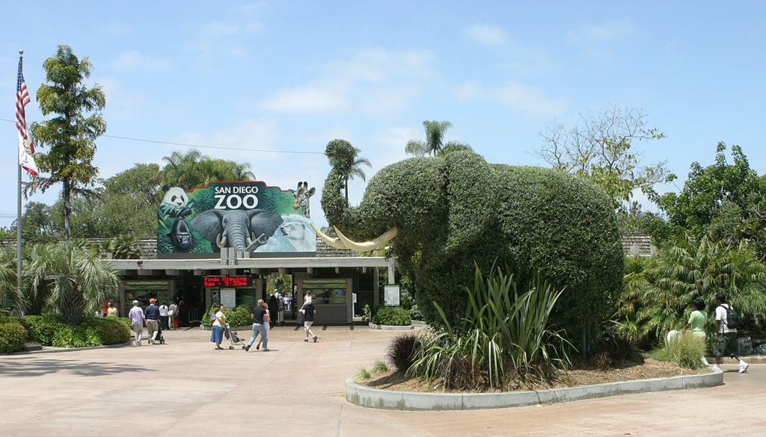
“in” and string comparison
Check if letter or substring is in a string
>>> 'a' in 'banana'
>>> 'ana' in 'banana'
Comparisons
>>> 'mouse' == 'mouse'
>>> 'Mouse' == 'mouse'
>>> 'elephant' > 'cow'
>>> 'dinosaur' < 'cat'
>>> 'mouse' > 'Zebra'
Notes:
https://en.wikipedia.org/wiki/Zoo

Slide 26
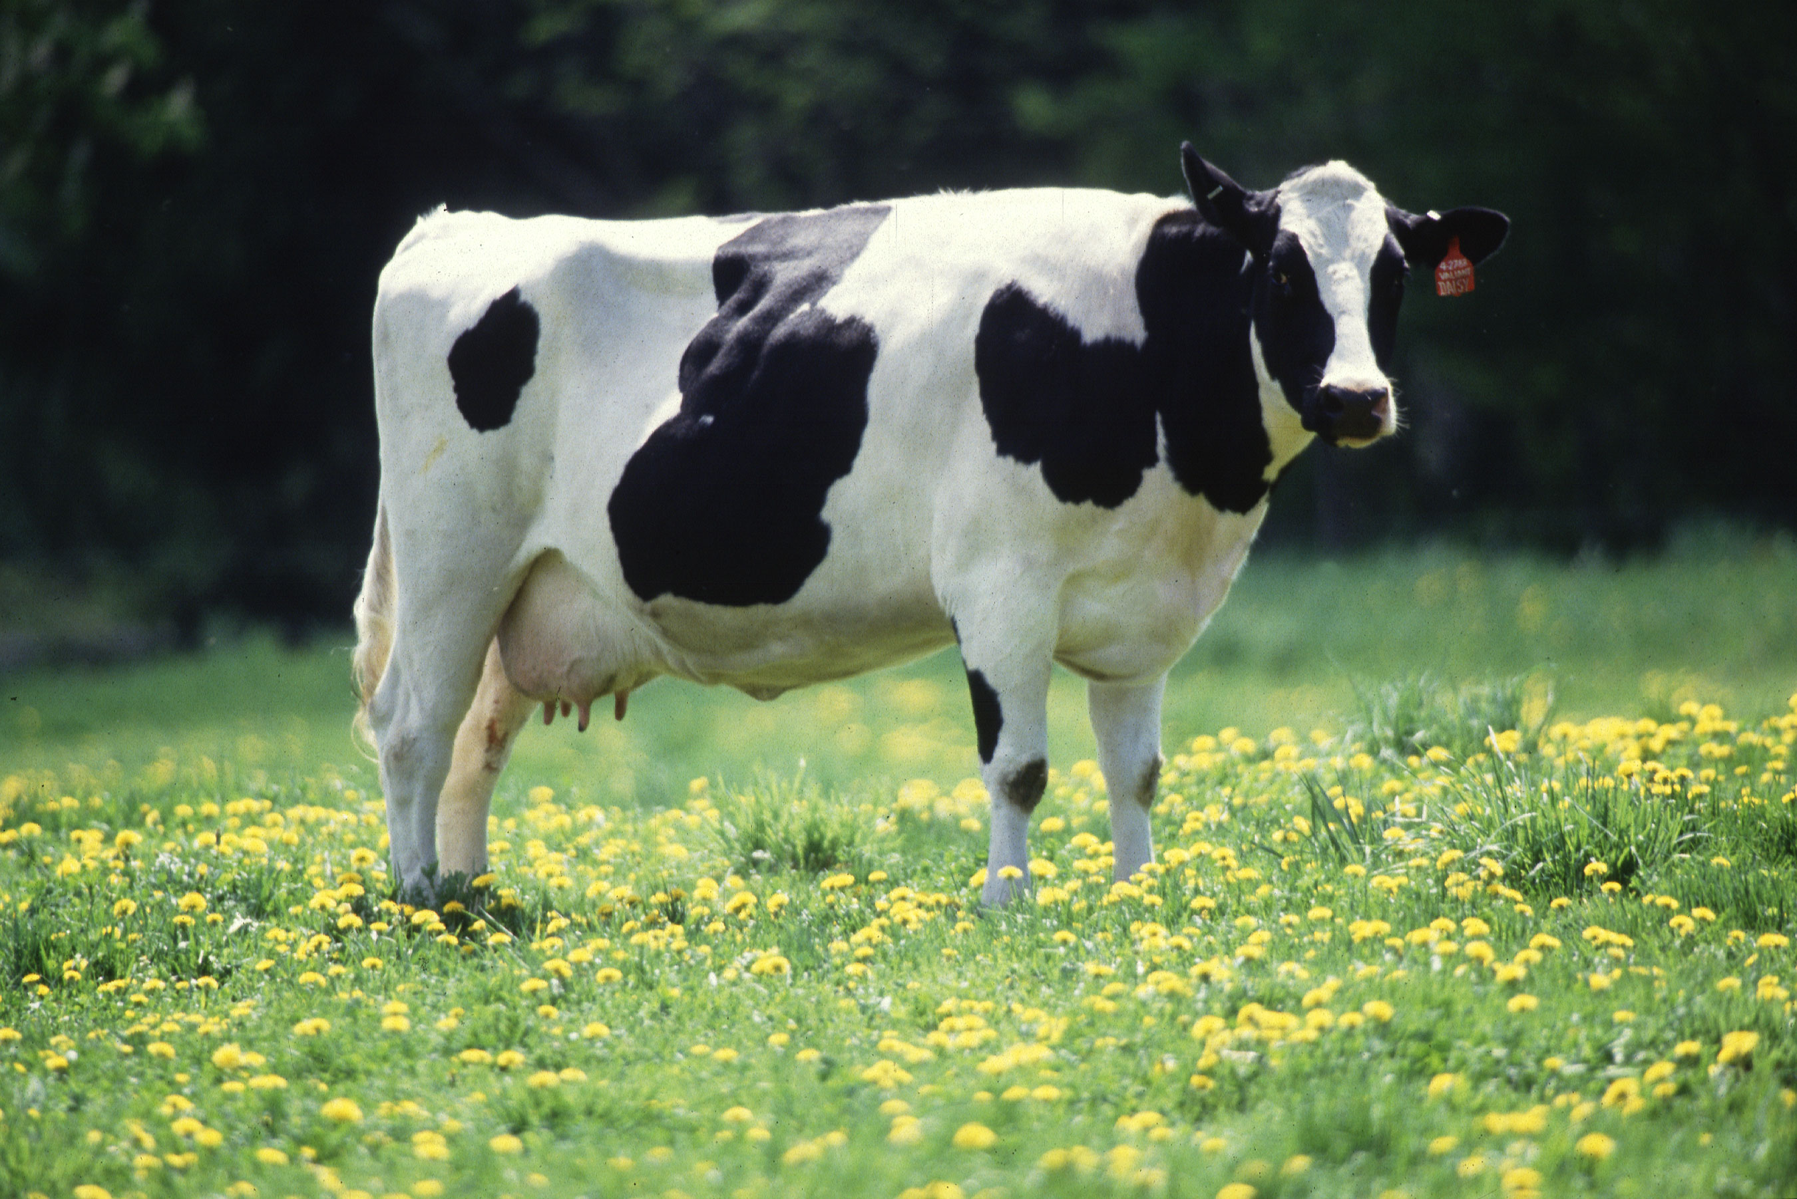
String methods
upper() / lower()
find()
startswith()
strip()
How to use this:
>>> s = 'cow'
>>> s.upper()
>>> type(s)
>>> dir(s)
>>> help(str.upper)
Notes:
https://en.wikipedia.org/wiki/Cattle

Slide 27
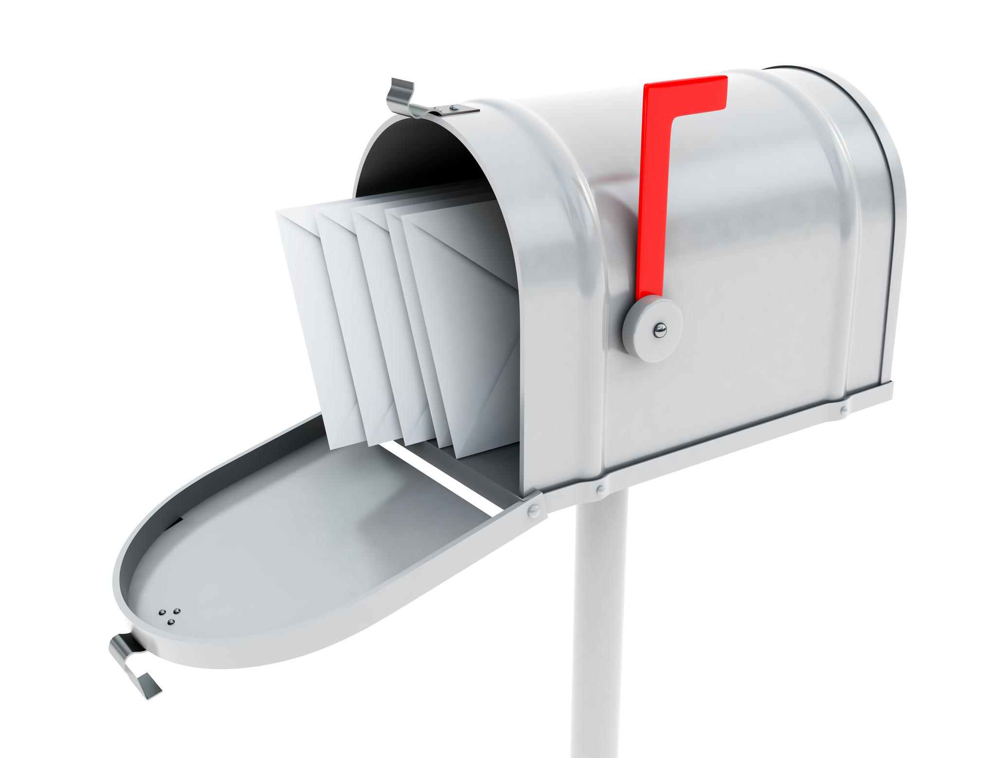
Parsing strings
>>> s = ' From: Barbera <barbera@van-schaik.org>'
>>> s.find("@")
23
>>> start = s.find("<")
>>> end = s.find(">")
>>> s[start:end]
'<barbera@van-schaik.org'
>>> s[start+1:end]
'barbera@van-schaik.org'
Notes:
http://prajwaldesai.com/create-user-mailbox-in-exchange-server-2013/

Slide 28
More
Chapter 6
  Format operator
Documentation string methods
  https://docs.python.org/3/library/string.html

Slide 29
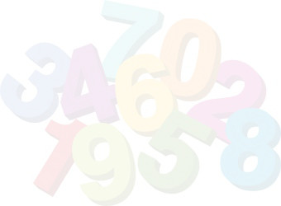
Assignment – guessing game
Write a program that generates a random number between 1 and 10
Let the user guess which number the computer had in mind
The user can guess at most 5 times
Give hints “higher” and “lower” when the guessed number is too high or too low
Partial code is available on the wiki
guess-game.py

Slide 30

Next week
Next: Files and lists
More programming exercise?
  Chapter 5 and 6 of the book
Tot volgende week!!

